Slide 1
Azure Redis Cache

Slide 2
Agenda
Introduction to Redis
Azure Redis Cache
Creating, Managing and Accessing an Azure Redis cache
Programmatically working with Azure Redis Cache
Working with simple objects
Working with .NET objects
Implementing a Pub-Sub Framework
Monitoring and Alerts
Further Reading

Slide 3
Introduction to Redis

Slide 4
What is Redis?
Redis is an acronym for REmote DIctionary Server
Redis is an open-source (BSD-licensed), in-memory data structure store
It can be compared to a key-value store like NoSQL or MongoDB
It has built-in replication, Lua scripting, LRU eviction, transactions and different levels of persistence
It provides high availability via Redis Sentinel and automatic partitioning with Redis Cluster

Slide 5
Why and where is it used?
As a database for storing data
As a cache for caching
As a message broker

Slide 6
How is Redis different from other NoSQL?
Redis is memory-based whereas others are disk-based
Redis supports more complex data types, with atomic operations defined on those data types

Slide 7
Difference between Redis and other databases and software
Name | Type | Data storage options | Query types | Additional features
Redis | In-memory non-relational database | Strings, lists, sets, hashes, sorted sets | Commands for each data type for common access patterns, with bulk operations, and partial transaction support | Publish/Subscribe, master/slave replication, disk persistence, scripting (stored procedures)
memcached | In-memory key-value cache | Mapping of keys to values | Commands for create, read, update, delete, and a few others | Multithreaded server for additional performance
MySQL | Relational database | Databases of tables of rows, views over tables, spatial and third-party extensions | SELECT, INSERT, UPDATE, DELETE, functions, stored procedures | ACID compliant (with InnoDB), master/slave and master/master replication
PostgreSQL | Relational database | Databases of tables of rows, views over tables, spatial and third-party extensions, customizable types | SELECT, INSERT, UPDATE, DELETE, built-in functions, custom stored procedures | ACID compliant, master/slave replication, multi-master replication (third party)
MongoDB | On-disk non-relational document store | Databases of tables of schema-less BSON documents | Commands for create, read, update, delete, conditional queries, and more | Supports map-reduce operations, master/slave replication, sharding, spatial indexes

Slide 8
How to install Redis?
For Windows OS:
Redis project doesn’t officially support Windows
Microsoft Open Tech group develops and maintains the Windows port
Download Link: https://github.com/dmajkic/redis/downloads

Slide 9
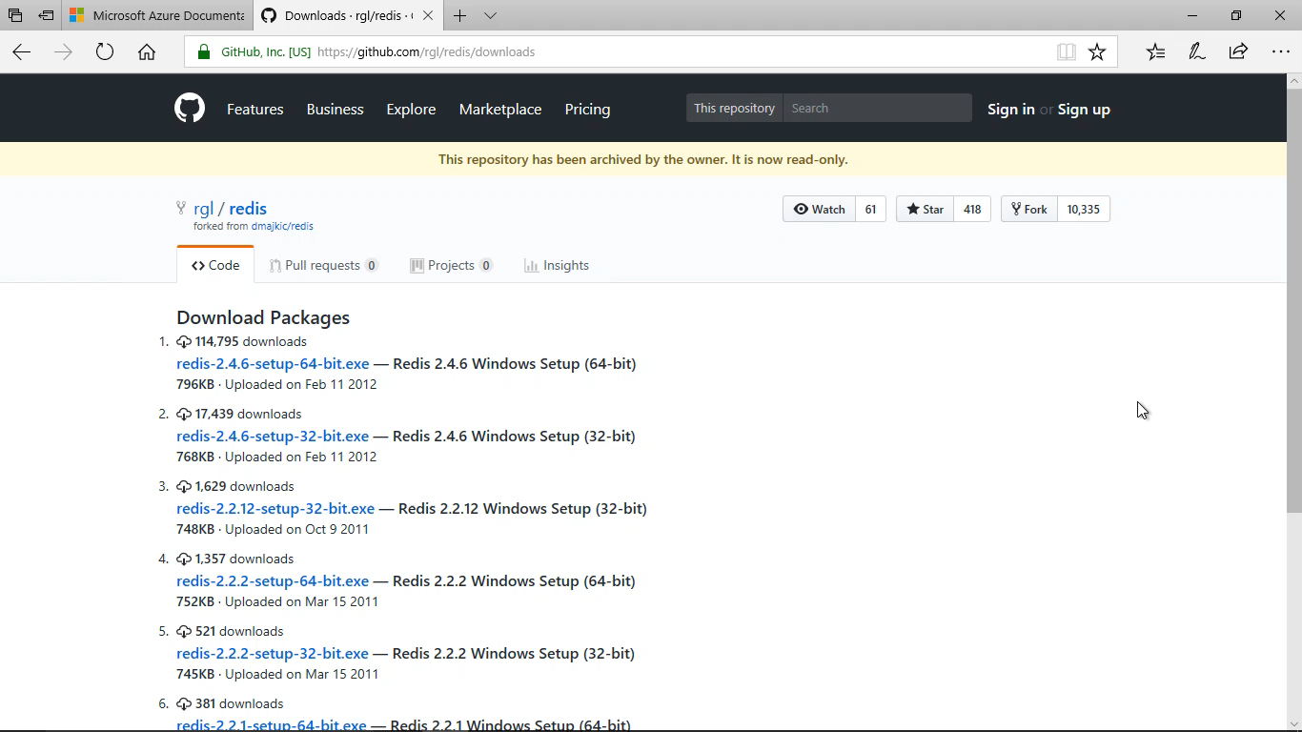

Slide 10
Redis Data Structures
Strings
Can contain strings, integers or floating-point values
List
Linked list of strings
Set
Unordered collection of unique strings
Hash
Unordered hash table of keys to values
Zset
Sorted set

Slide 11
Structure type | What it contains | Structure read/write ability
STRING | Strings, integers, or floating-point values | Operate on the whole string, parts, increment/ decrement the integers and floats
LIST | Linked list of strings | Push or pop items from both ends, trim based on offsets, read individual or multiple items, find or remove items by value
SET | Unordered collection of unique strings | Add, fetch, or remove individual items, check membership, intersect, union, difference, fetch random items
HASH | Unordered hash table of keys to values | Add, fetch, or remove individual items, fetch the whole hash
ZSET (sorted set) | Ordered mapping of string members to floating-point scores, ordered by score | Add, fetch, or remove individual values, fetch items based on score ranges or member value

Slide 12
Redis Commands
The SET command stores a value with a specified key:
SET name “TechM”
The GET command helps to retrieve the value stored in the key:
GET name => “TechM”
Numeric values can be incremented with INCR command
SET value 10 => 10
INCR value => 11
INCR value => 12
DECR command decrements the value
DEL value => 11

Slide 13
Demo

Slide 14
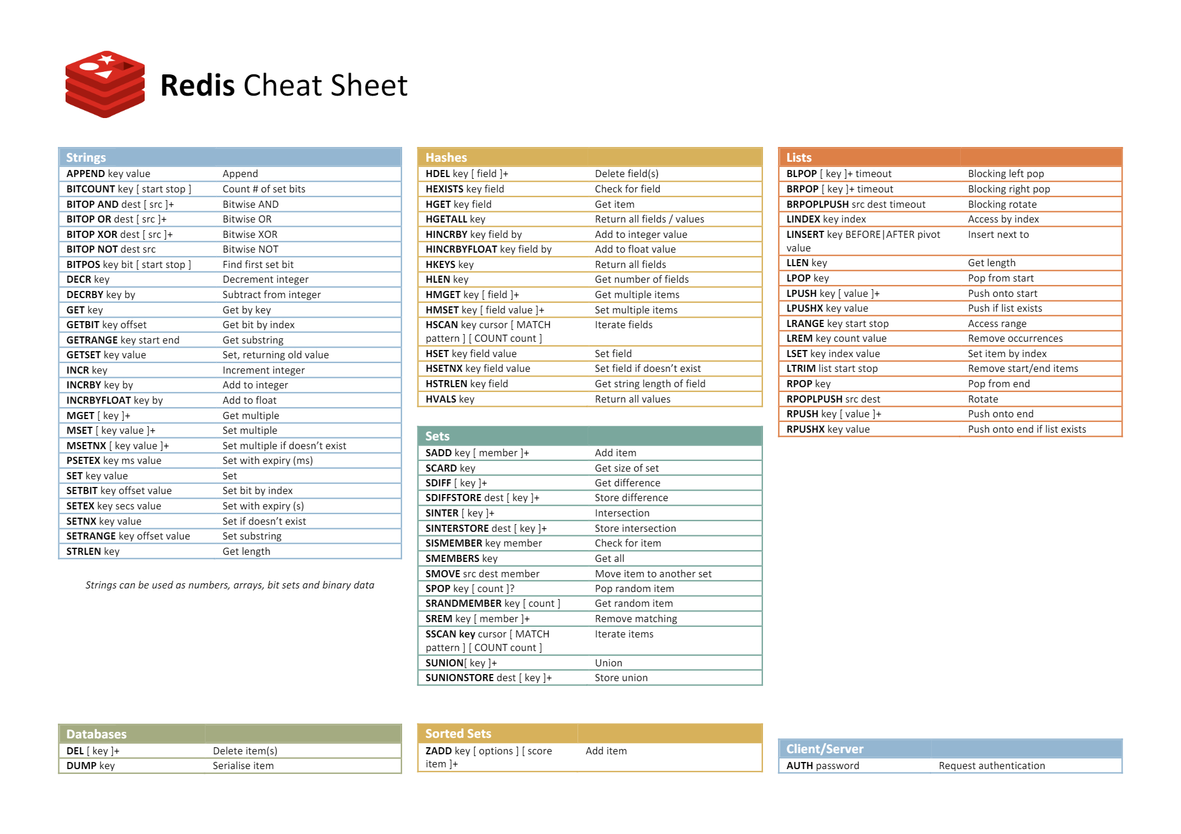

Slide 15
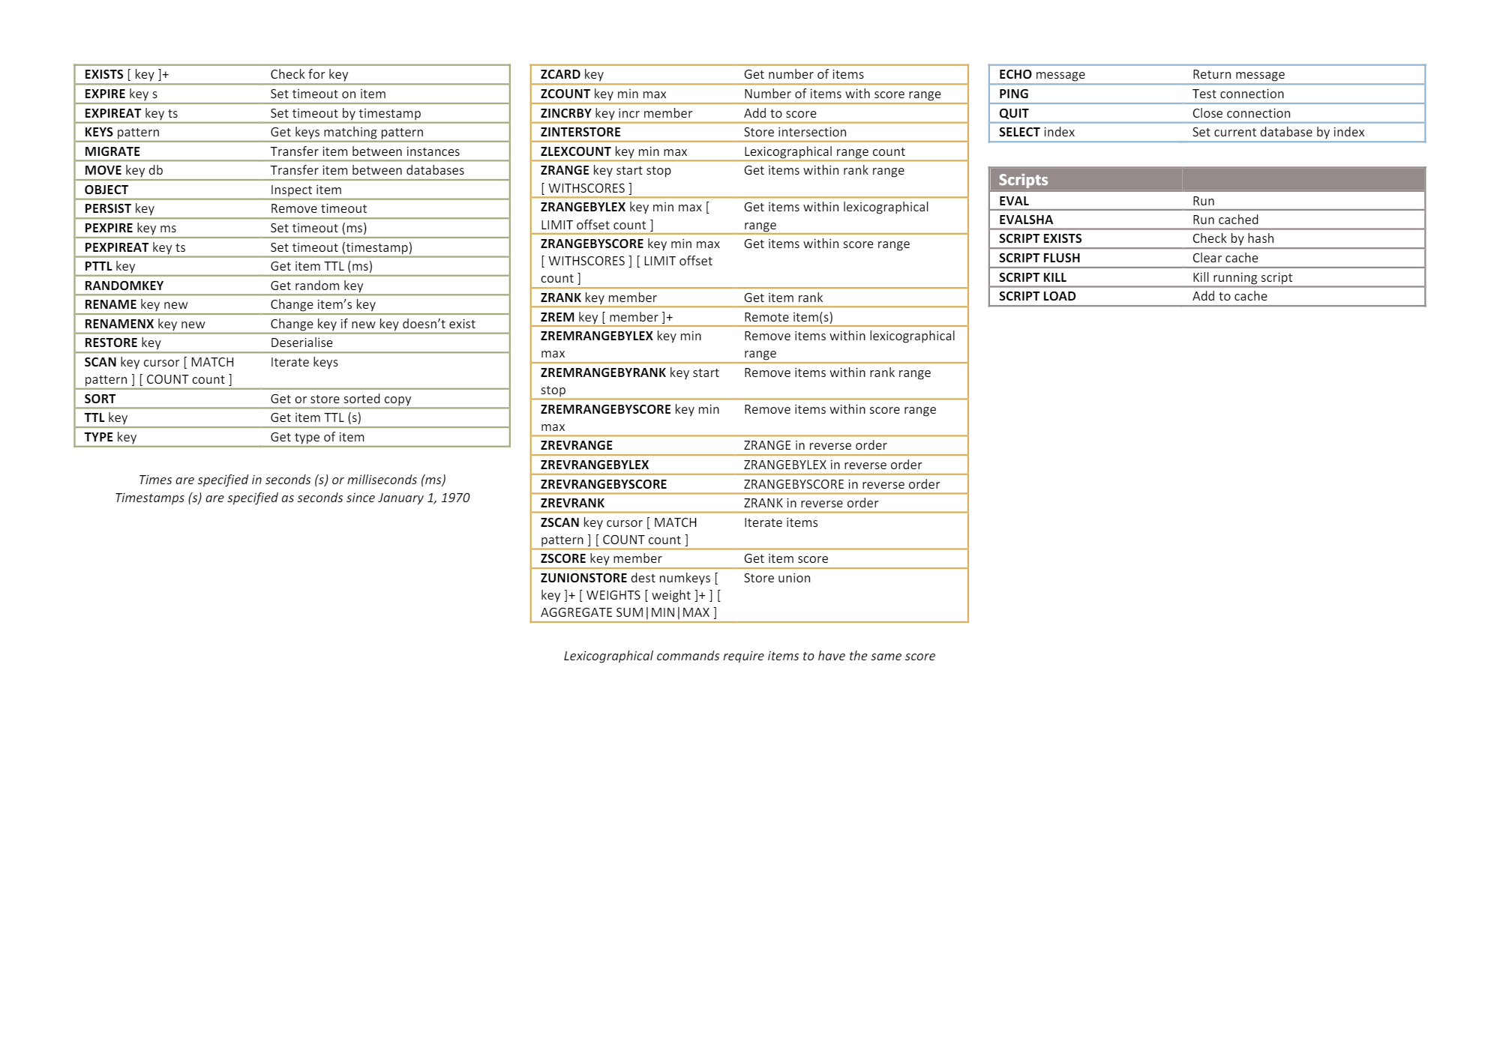

Slide 16
Azure Redis Cache

Slide 17
Azure Redis Cache
Based on the open-source Redis cache
Gives a secure, dedicated Redis cache, managed by Microsoft and accessible by any application within Azure
Available in different tiers
Basic – Single node, multiple sizes, ideal for test/dev
Standard – Replicated cache in a 2-node primary/secondary configuration. Upto 53 GB.
Premium – Standard tier features plus better performance, bigger workloads, disaster recovery, enhanced security, etc. Upto 530 GB.

Slide 18
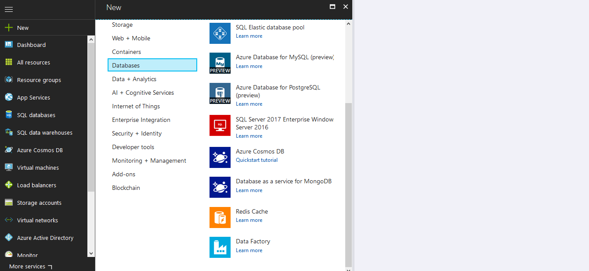
Creating a Redis cache

Slide 19
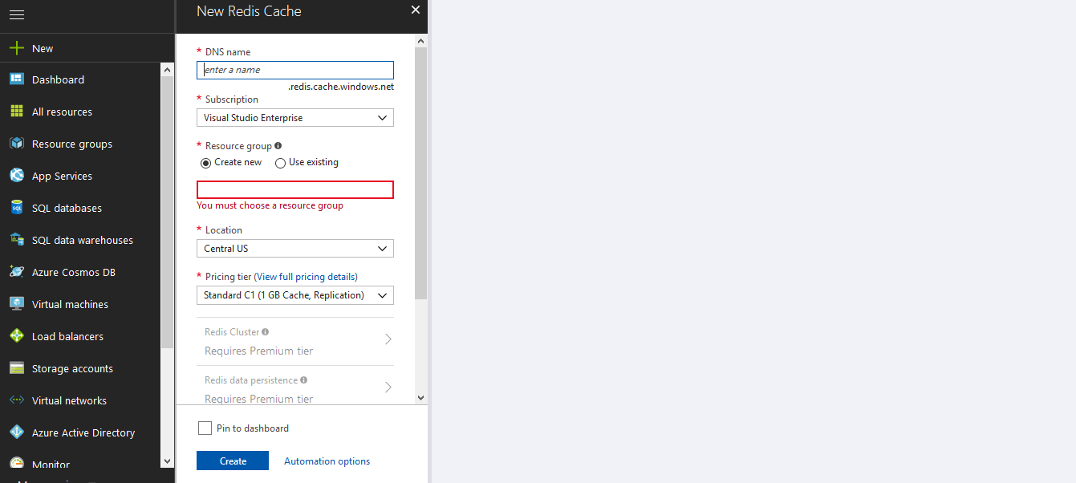
Creating a Redis cache

Slide 20
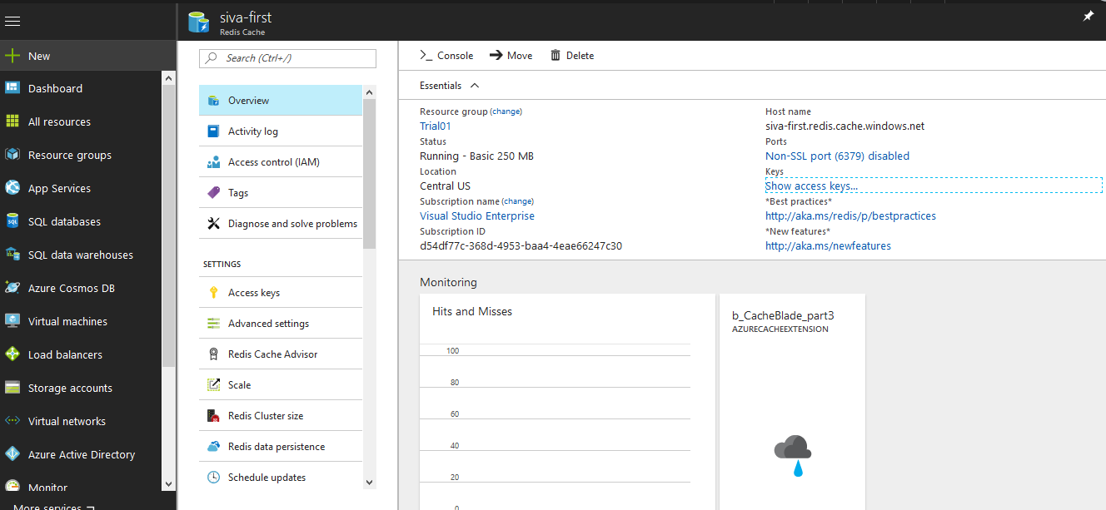
Managing a Redis cache

Slide 21
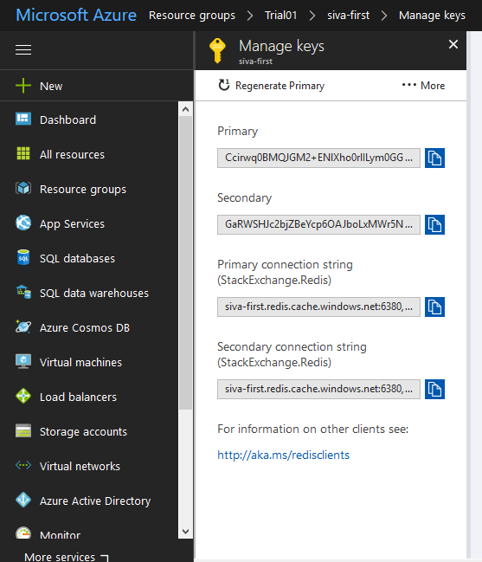
Accessing a Redis cache

Slide 22
Working with Caches
Connecting to the cache
Add and retrieve objects from cache
Work with .NET objects in the cache

Slide 23
Connecting to the cache
Install the StackExchange.Redis Nuget package to your project
Install-Package StackExchange.Redis
Add the StackExchange.Redis namespace to your .cs file
Use the static Connect method of the ConnectionMultiplexer class

Slide 24
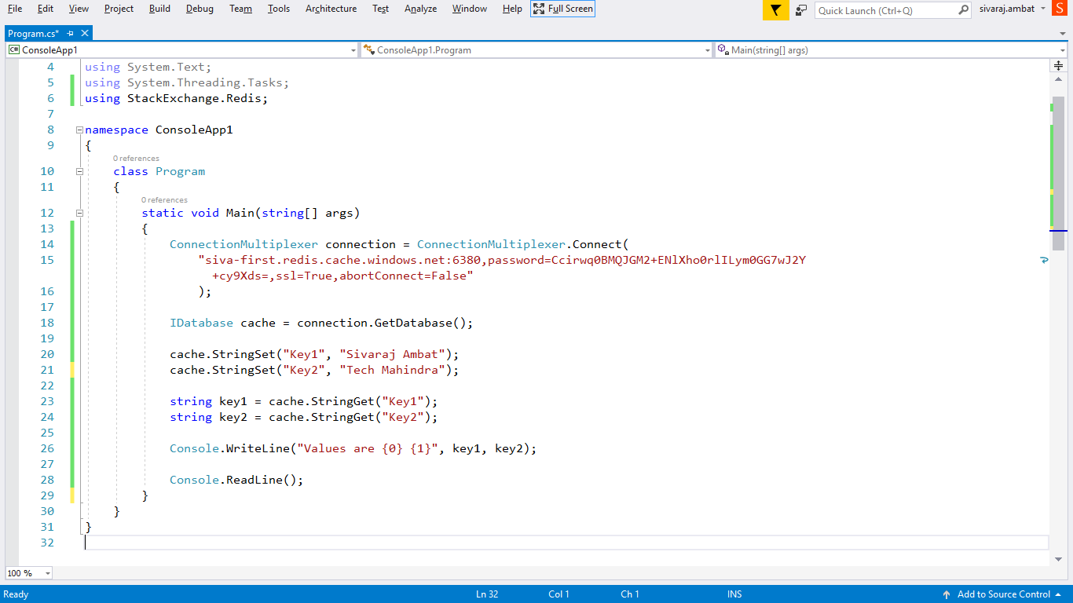
Working with string objects in cache

Slide 25
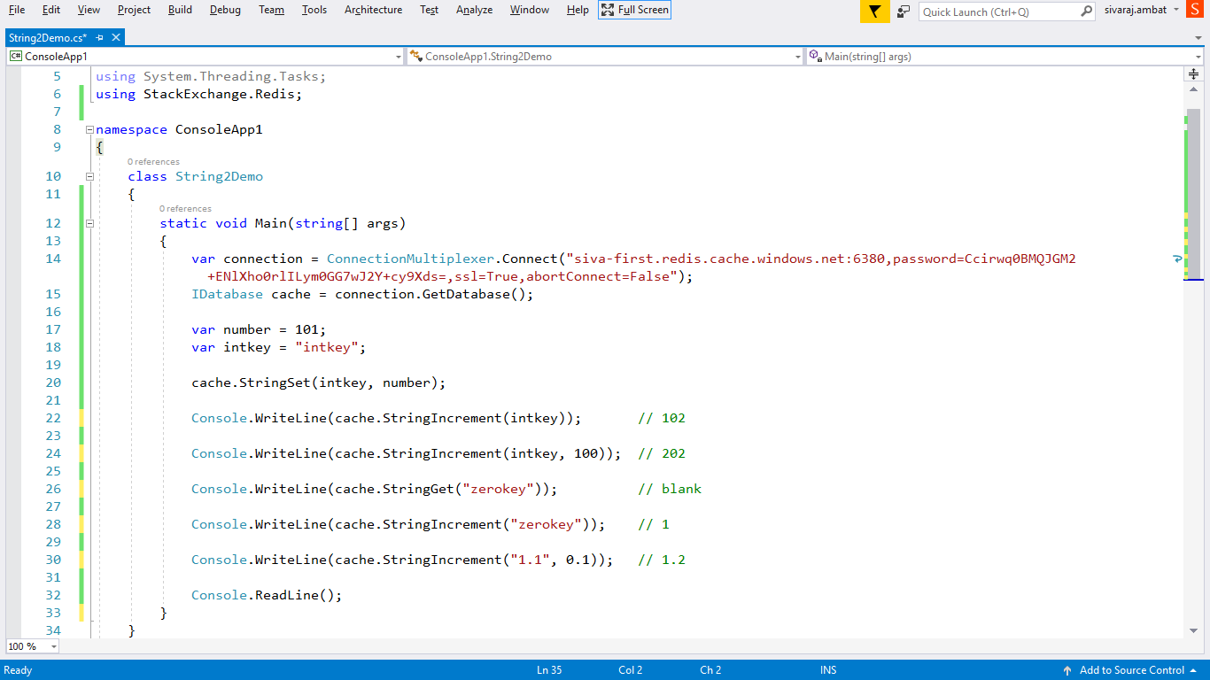
Using int and float

Slide 26
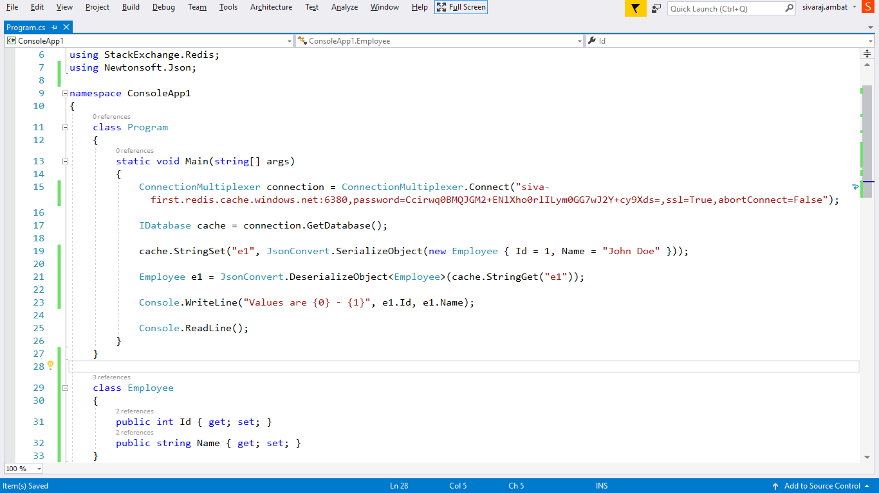
Working with .NET objects in cache

Slide 27
Pub-Sub Framework
Redis uses a listener model where if there are no listeners (subscribers) it will not receive any messages

Slide 28
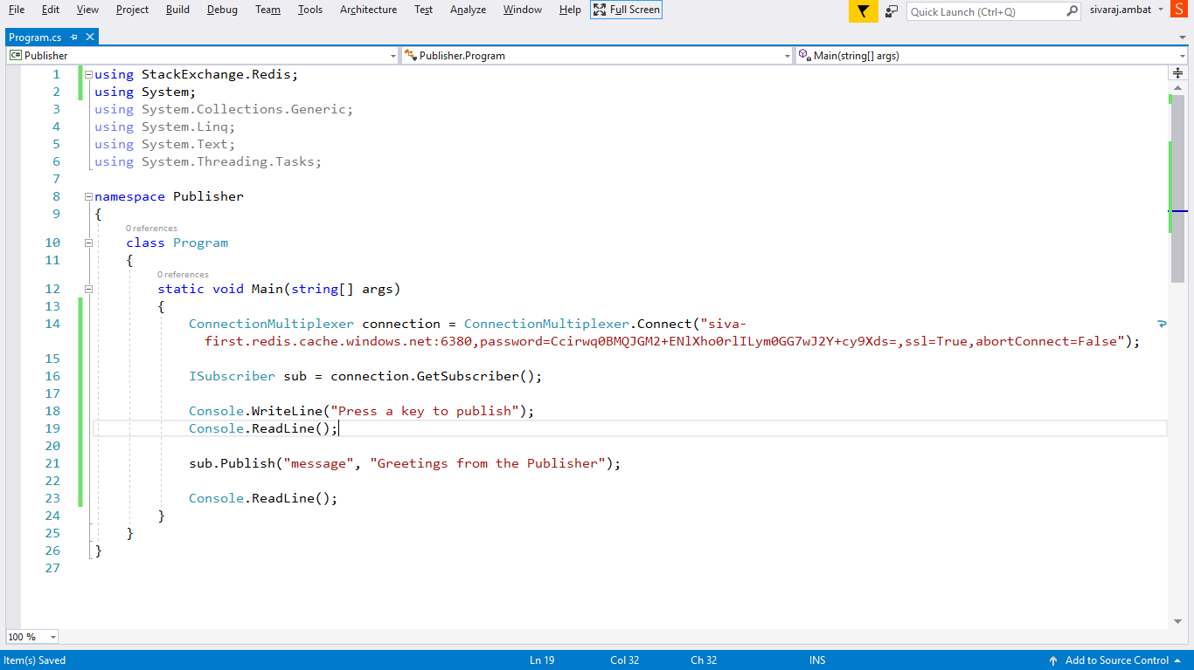
Publisher

Slide 29
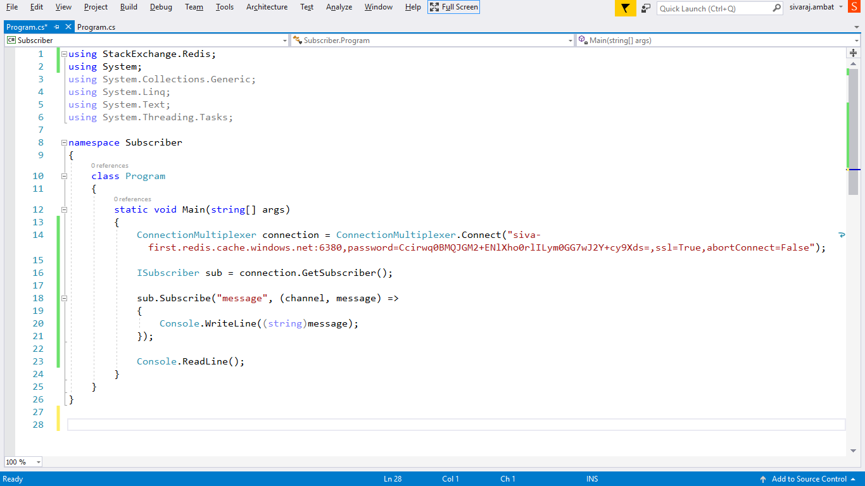
Subscriber

Slide 30
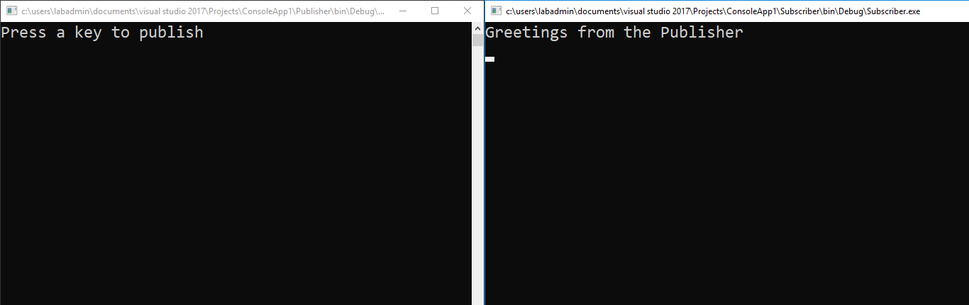
Publisher
Subscriber

Slide 31
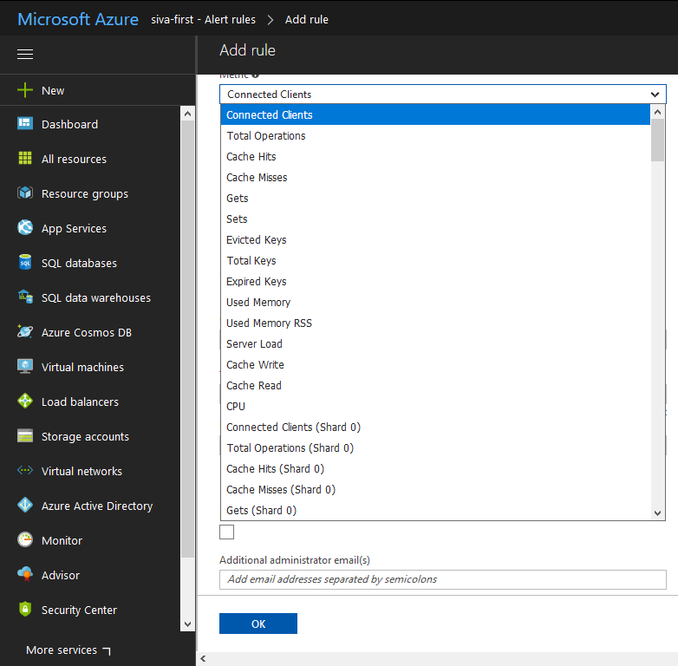
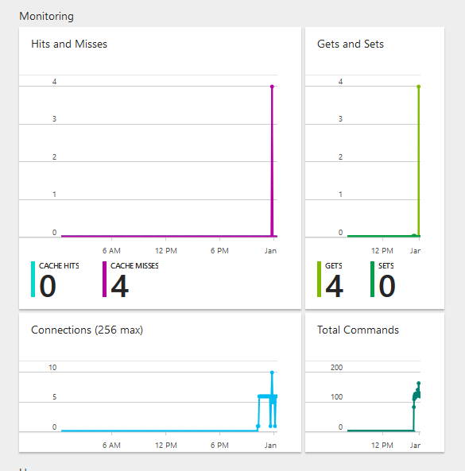
Monitoring and Alerts

Slide 32
Further reading
https://docs.microsoft.com/en-in/azure/redis-cache/
https://azure.microsoft.com/en-gb/resources/samples/?service=redis-cache&sort=0
https://docs.microsoft.com/en-in/dotnet/api/overview/azure/redis-cache?view=azure-dotnet

Slide 33
Thank you
Technical Learning Services

